Slide 1
Dictionary
Python Class #6
HEHology

Slide 2
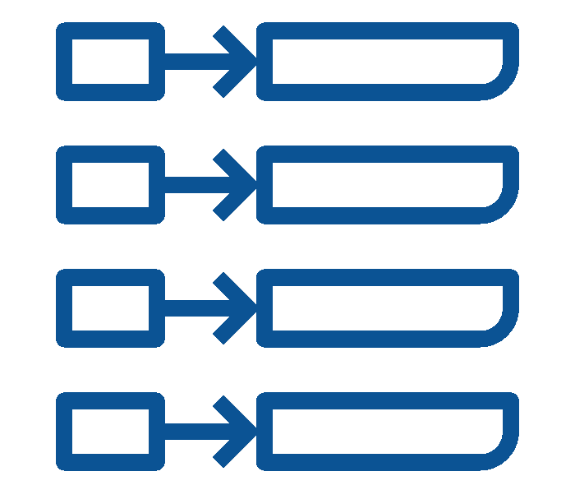
Dictionary
Unordered collection
Key instead of index
Key to value
Use account to find password
(account -> password)
To find a book in a library
(catalogue -> book)
(call number -> book)
Prime minister is Justin Trudeau
(prime minister -> Trudeau)
‹#›
HEHology

Slide 3
Dictionary
Key-value can be different
int
string
boolean
float
‹#›
HEHology

Slide 4
Dictionary
Locate a value with key instead of index
Index could mean nothing
Prime ministers -> last one -> Justin Trudeau
Prime ministers -> 23rd -> Justin Trudeau
Library -> LB2395.C651991 -> Alice in Wonderland
Library -> ith book -> Alice in Wonderland
‹#›
HEHology

Slide 5
Defining Dictionary
capitals = {
"China" : "Beijing",
"Canada" : "Ottawa",
"U.S.A." : "Washington"
}
capitals= {}
‹#›
HEHology

Slide 6
CRUD

Slide 7

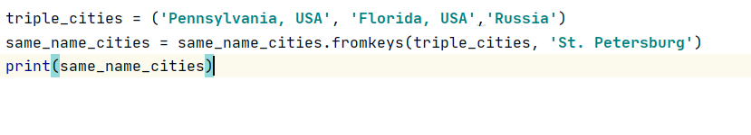
C is for Create
Basic key-value adding
capitals["Key"] = "Value"
copy()
Duplicates dictionary
cities = capitals.copy()
fromkeys()
Registers 3 keys with same values
‹#›
HEHology

Slide 8

R is for Read
get()
Returns the value from the key
capitals.get("China")
items()
Returns a list of key-value pairs
print(capitals.items())
keys()
Returns all the keys in the dictionary
print(capitals.keys())
values()
Returns all the values in the dictionary
print(capitals.values())
‹#›
HEHology

Slide 9

U is for Update
+1 item
capitals["United Kingdom"] = "London"
Add one item to the dictionary
setdefault()
Adds key and value if nonexistent key
capitals.setdefault('Italy', 'Rome')
capitals.setdefault('U.S.A.', 'Washington')
update()
Updates list with key-value pairs
capitals.update({'Spain': 'Madrid'})
‹#›
HEHology

Slide 10

D is for Delete
pop()
Removes key and its value
capitals.pop('Canada')
popitem()
Removes last key-value pair
capitals.popitem()
clear()
Deletes everything
capitals.clear()
del
‹#›
HEHology

Slide 11

Thanks!
Any questions?
HEHology

